Slide 1

School of Computing Science and Engineering
Course Code: BCS01T1003 Course Name: Programming for Problem Solving C
UNIT 2
CONSTRUCTS OF C
Datatypes, Variables and Identifiers
Faculty Name: Atul Kumar Singh Program Name: B.Tech (CSE)

Slide 2
Recapitulations
History of C
Features of C
Uses of C
Structure of a C Program
The Greeting Program

Slide 3
Objectives
Process of writing a C program
C Character Set
C Tokens
Keywords
Identifiers/Variables
Constants
Datatypes in C

Slide 4
Steps for creating a C program
Step 1: Write the source codes (.c).
Step 2: Pre-process the source codes according to the preprocessor directives
Step 3: Compile the pre-processed source codes into object codes (.obj, .o).
Step 4: Link the compiled object codes with other object codes and the library object codes (.lib, .a)to produce the executable code (.exe).
Step 5: Load the executable code into computer memory.
Step 6: Run the executable code.

Slide 5
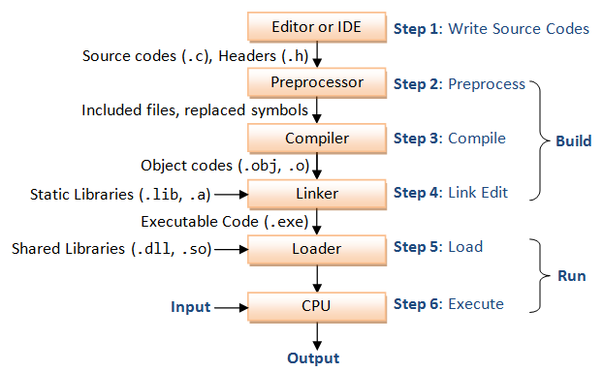
Steps for creating a C program

Slide 6
C Character Set
A character denotes any alphabet, digit or special symbol used to represent information.
Valid Character Set for C is as follows:
Alphabets -> A, B, … , Y, Z; a, b, …, y, z
Digits -> 0, 1, 2, 3, 4, 5, 6, 7, 8, 9
Special Symbols -> ~ ‘ ! @ # $ % ^ & * ( ) _ - + = | \ / [ ] { } ; : “ < > , .
The alphabets, numbers and special symbols when properly combined form constants, variables and keywords.

Slide 7
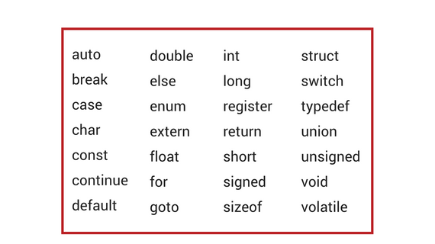
Keywords
Words whose meaning has already been explained to C compiler.
They cannot be used as variable names.
They are also called as Reserved words.
There are 32 keywords in C.

Slide 8
Identifiers/ Variables
Identifiers are the names given to anything for the purpose of identification.
User defined names given to functions, memory locations, etc.
An entity that may vary during program execution is called a variable.
Variable names are given to locations in memory
Rules for variable names/ identifiers:
Stick to 31 characters at maximum for names.
The 1st character must be an alphabet or underscore.
No commas, blanks are allowed
No special symbol other than underscore (eg. Gross_salary)
A variable name always has an associated type with it to identify what kind of value it can store. Eg. int num1, char ch

Slide 9
Constants
A constant is an entity that doesn’t change.
Integer constants
can be positive or negative (eg. 426, +765, -7606)
Range is -32768 to 32767 for 16 bit compiler.
Real constants/ Floating point constants
- Must have a decimal point, can be positive or negative, by default is positive.
Has 2 forms: fractional and exponential
Fractional form: eg. 32.34, -21.09, +98.12
426.9 is positive
Exponential form: has mantissa part and exponential part separated by e
eg. +3.2e-5, 4.1e8, -1.2e+3

Slide 10
Constants
Character constant
single alphabet, digit or special character within ‘ ‘.
each character constant has an ASCII code.
‘A‘ has an ASCII code 65 and ‘a‘ has an ASCII code 97.
String constants
They are between “ “.
Eg. “Hello“, “world“, “ab12“.
“A“ not equal to ‘A‘.
Special character constants
\ (back-slash character) used in output functions.
Eg. ‘\n‘ : newline; ‘\t‘: horizontal tab; ‘\0‘: null character.
‘\n’ though has two characters, is considered as single character only.

Slide 11
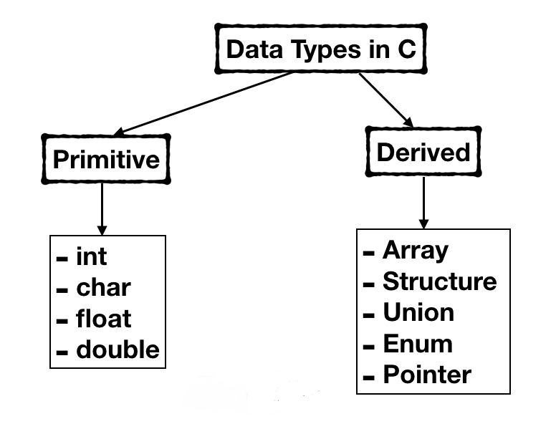
Datatypes in C
Datatypes are needed to inform compiler about what kind of values can be stored in a particular variable.
It gives information like size of the variable in memory, range of permitted values, and type of values.
Two types: Primitive and Derived.
Primitive data types are basic datatypes provided by compiler.
Derived datatypes are an extension of primitive datatypes.

Slide 12
Datatypes
char
Range -128 to +127
Size is 1 Byte
Format specifier: %c
int
Range -32768 to +32767
Size is 2 Bytes
Format specifier: %d
float
Range -3.4e38 to +3.4e38
Size is 4 Bytes
Format specifier: %f
double
Range -1.7e308 to +1.7e308
Size is 8 Bytes
Format specifier: %lf

